Slide 1
Privacy in Healthcare
Yichun Zhou

Slide 2
Privacy in Healthcare
Maintaining the security and confidentiality of patient records.
Modern concerns
the degree of disclosure to insurance companies, employers, and other third parties.
electronically stored health records

Slide 3

Overview
Health Information Privacy Law
HIPAA
HITECH Act
Electronic Health Record (EHR)

Slide 4

HIPAA
Health Insurance Portability and Accountability Act of 1996
United States legislation
provides data privacy and security provisions for safeguarding medical information
The act contains five sections or titles

Slide 5
HIPAA cont.
Title I protects health insurance coverage for workers and their families when they change or lose their jobs
Title II known as the Administrative Simplification (AS) provisions, requires the establishment of national standards for electronic health care transactions and national identifiers for providers, health insurance plans, and employers
Title III sets guidelines for pre-tax medical spending accounts
Title IV sets guidelines for group health plans
Title V governs company-owned life insurance policies

Slide 6
Main Purposes of HIPAA
Modernize the flow of healthcare information
Regulate how Personal Information maintained by the healthcare industries should be protected from fraud and theft
Address limitations on healthcare insurance coverage

Slide 7

HITECH Act
Health Information Technology for Economic and Clinical Health Act of 2009
Stimulate the adoption of electronic health records (EHR) and the supporting technology in the United States
Four subtitles
Subtitle A: Promotion of Health Information Technology
Subtitle B: Testing of Health Information Technology
Subtitle C: Grants and Loans Funding
Subtitle D: Privacy (closely related to HIPAA)

Slide 8

Impact on Health IT
Electronic Health Record (EHR)
EHR Adoption Rate
14.2%
3.2%
2008 2015
Notes:
One of the major impacts of the HITECH Act is that the rate of EHR adoption for eligible hospitals increased from 3.2% to 14.2% from 2008 to 2015.

Slide 9

HITECH Act vs. HIPAA
Separate and independent laws, but they do reinforce each other in certain ways.
For example
HITECH stipulates that technologies and technology standards created under HITECH will not compromise HIPAA privacy and security laws.
HITECH also requires that any physician or hospital that attests to meaningful use must have performed a HIPAA security risk assessment.

Slide 10

Electronic Health Record (EHR)
a digital version of a patient’s paper chart.
a real-time, patient-centered record that makes information available instantly and securely.
an individual's official health document that is shared among multiple facilities and agencies (authorized users).

Slide 11



EHR cont.
Contain patients’ medical data, including visit history, diagnoses, medications, allergies, test results and etc.
Allow access to evidence-based tools that providers can use to make decisions about a patient’s care
help to automate and streamline providers’ workflow

Slide 12

EHR Security
Baseline
EHRs in the U.S. must be HIPAA compliant
The HITECH Act also provides regulations
other security features
Audit trail system
State-of-the-art data centers
Access control tools
Encryption
....

Slide 13
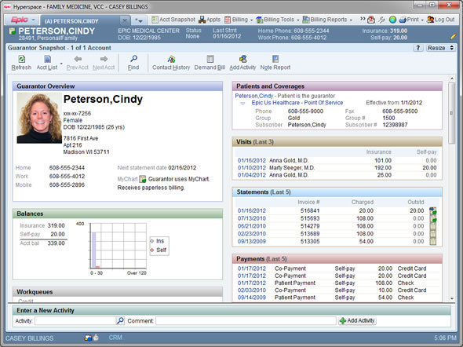
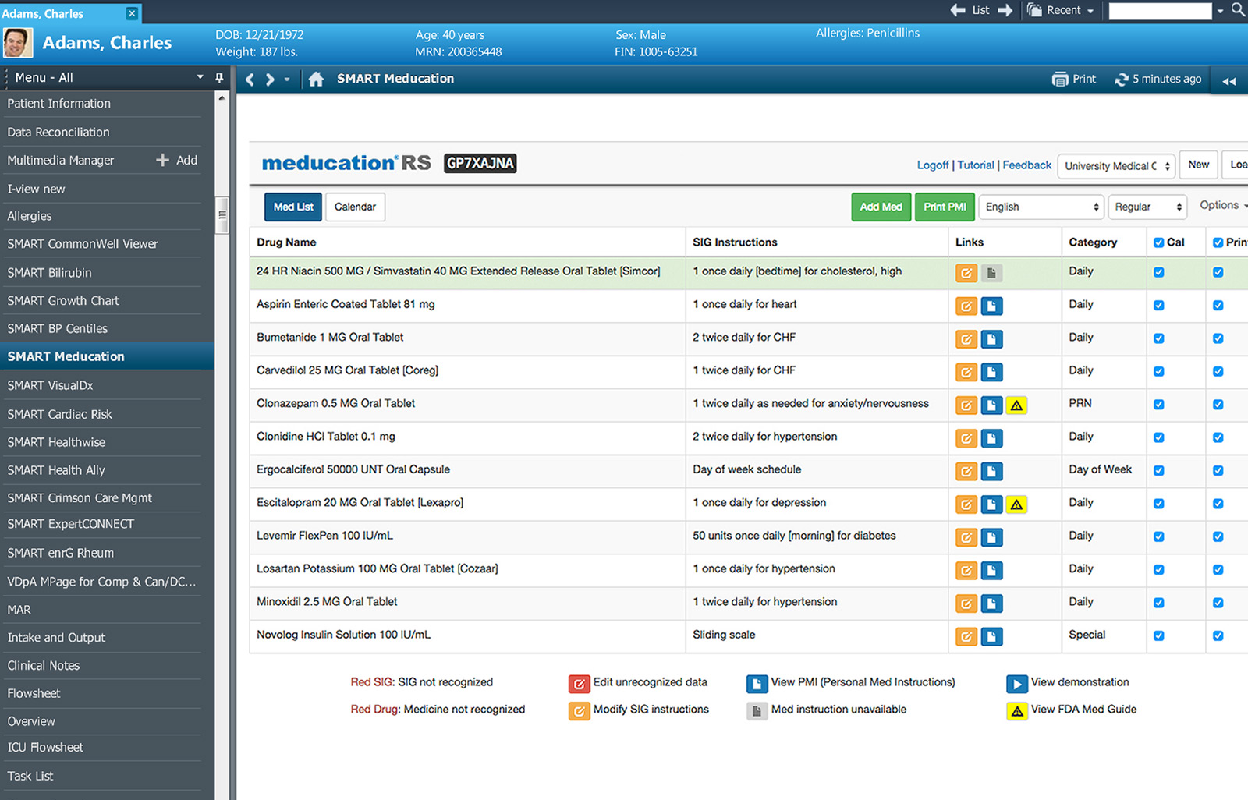
EHR vendors for hospitals
Epic Systems Corporation and Cerner Corporation

Slide 14
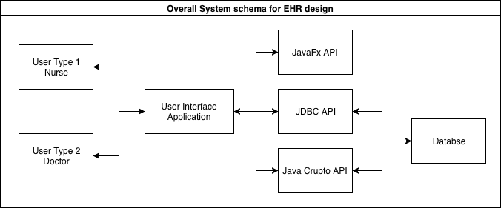
EHR System and Database Design

Slide 15
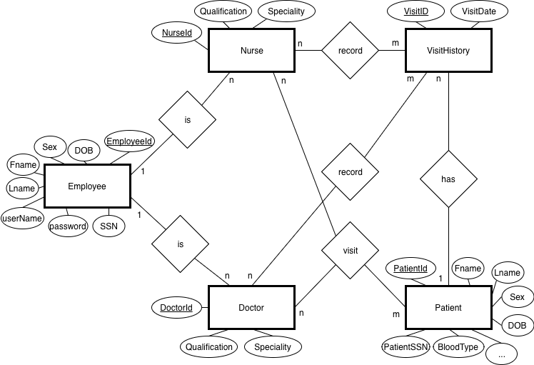
Notes:
1:n relationship between Employee and Doctor and Employee and Nurse as a there could be many doctors as employees, and one doctor can only register once as an employee. The same relationship between Employee and Nurse entities.

Slide 16
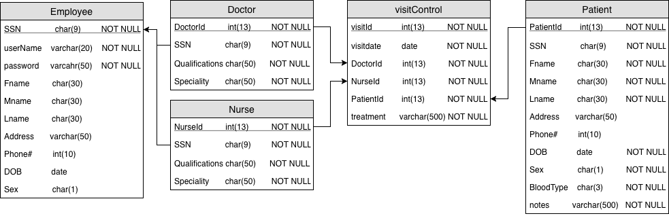

Slide 17
References
https://en.wikipedia.org/wiki/Medical_privacy
https://searchhealthit.techtarget.com/definition/HIPAA
https://searchhealthit.techtarget.com/definition/HITECH-Act
https://en.wikipedia.org/wiki/Health_Insurance_Portability_and_Accountability_Act
https://en.wikipedia.org/wiki/Health_Information_Technology_for_Economic_and_Clinical_Health_Act
https://www.sciencedirect.com/science/article/pii/S1877050915025764
https://www.healthit.gov/faq/what-electronic-health-record-ehr
https://www.academia.edu/27145315/DESIGN_AND_IMPLEMENTATION_OF_PATIENT_MANAGEMENT_SYSTEM
https://searchhealthit.techtarget.com/definition/electronic-health-record-EHR

